Slide 1

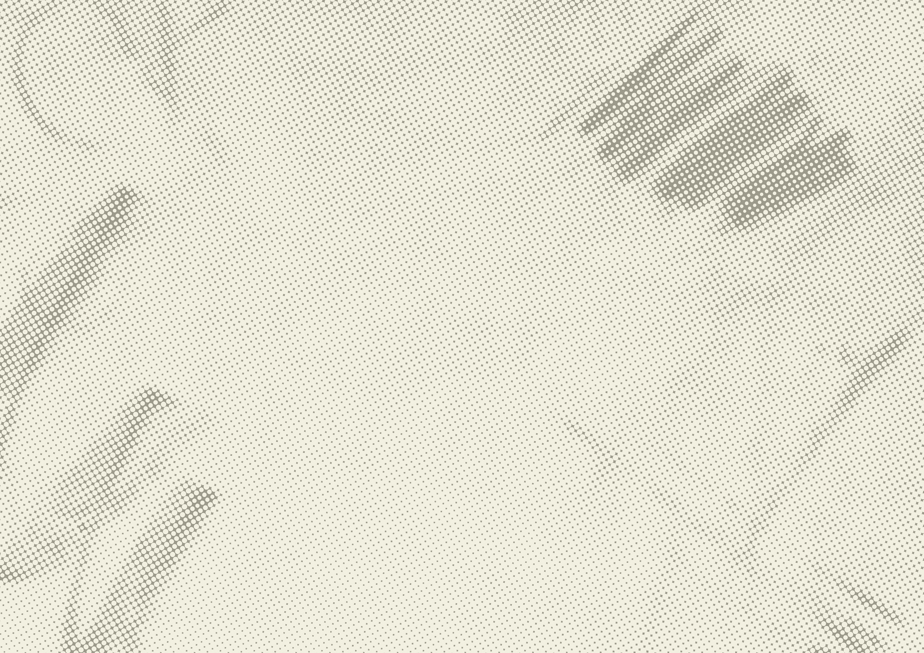




Ada Art Workshop
Drawing Her Story: Exploring Local History and Activism through Art

Slide 2
Who was Ada Nield Chew?
Eldest daughter of 13 siblings
Left school at 11 to help her mum with childcare and housework
Became a factory worker in Crewe in the late 1800s
Wrote anonymous letters about working conditions
Became a suffragist and campaigner for women’s rights and social justice
Used her voice to speak up for unfair working conditions and wages

Slide 3
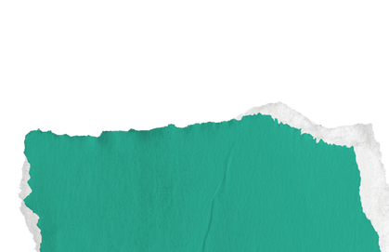

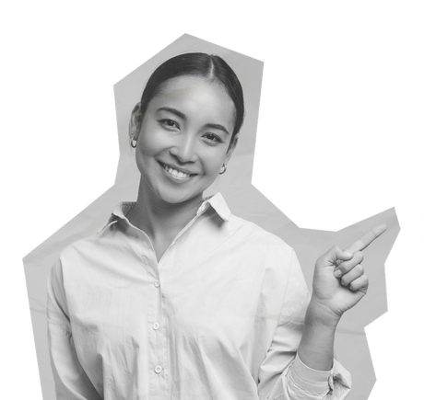

Workshop Aims & Outcomes
Learn about Ada’s story and legacy
Use drawing and creativity to explore her life
Reflect on women’s empowerment, past and present
Express your ideas through art

Slide 4
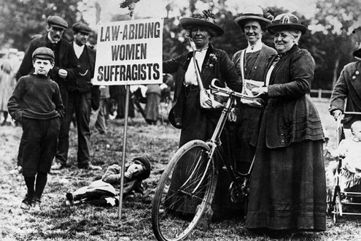
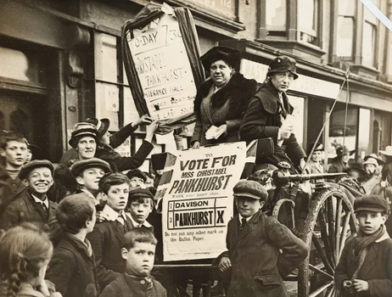
Activity 1: Draw Your Ada
Imagine what Ada might have looked like.
What would her expression be?
What did women look like and wear at the time (18-1900s)
Was she strong, tired, determined, hopeful?
Draw your version of Ada.

Slide 5
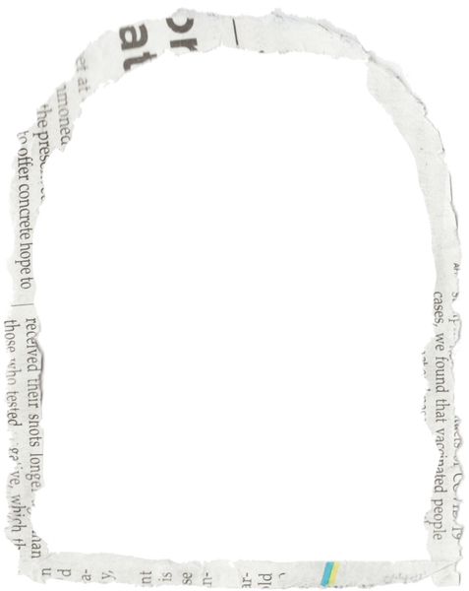
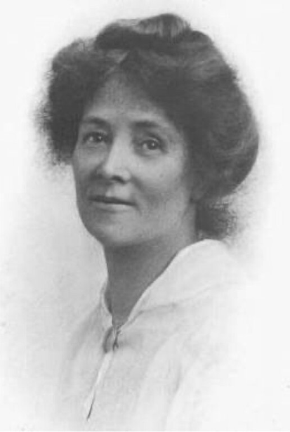
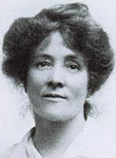
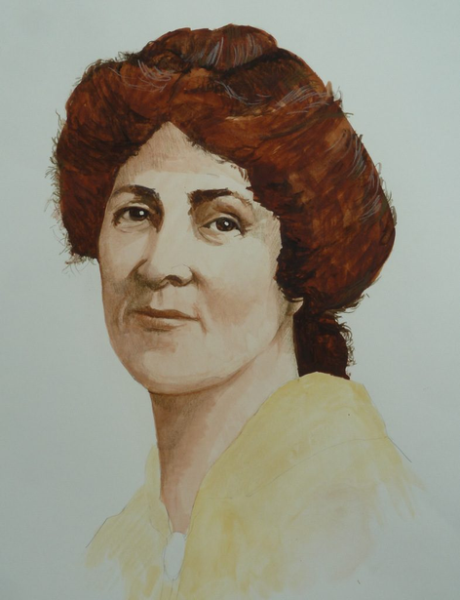
The Real Ada
Were you close?

Slide 6
Activity 2: Factory Life
Draw what the factory might have looked like where Ada worked.
Think about: the outside, the inside, machinery, workers, noise, space, feeling.
What would it be like to work there?

Slide 7
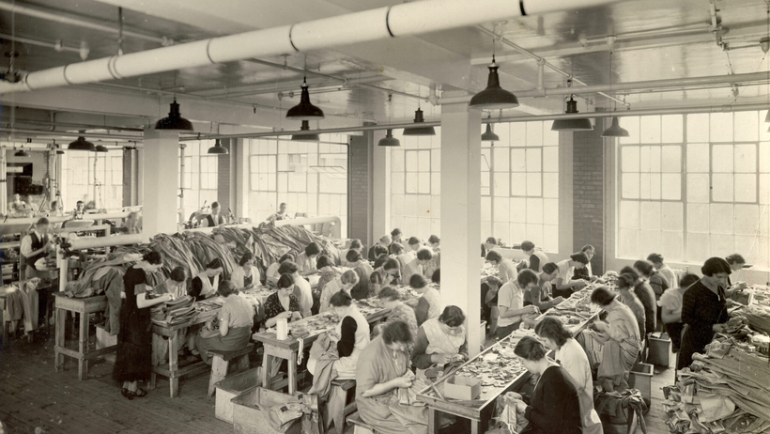
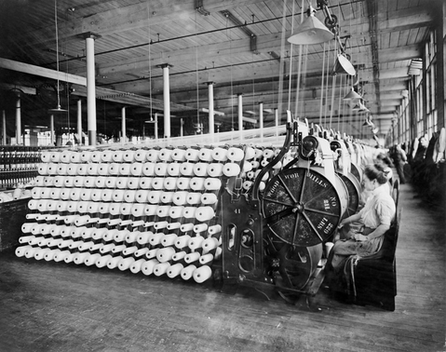
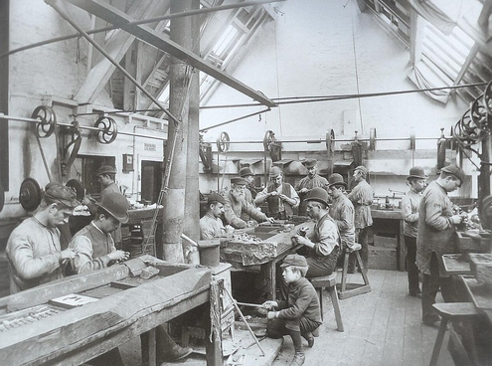
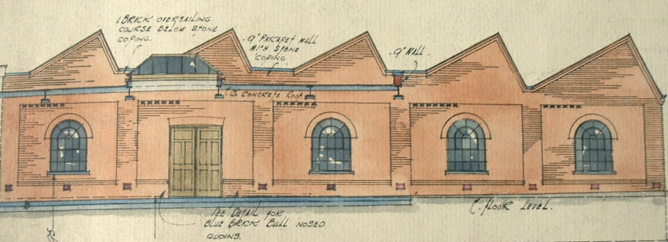
The Factory

Slide 8
Activity 3: Wear Her Words
Design a piece of clothing or pattern using Ada’s words.
Use symbols, shapes, quotes, and colours
What message do you want to show?
How can art tell a story of resistance or hope?

Slide 9
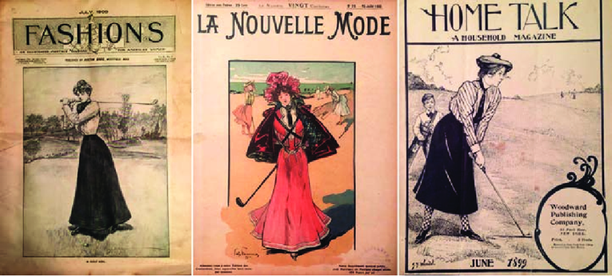
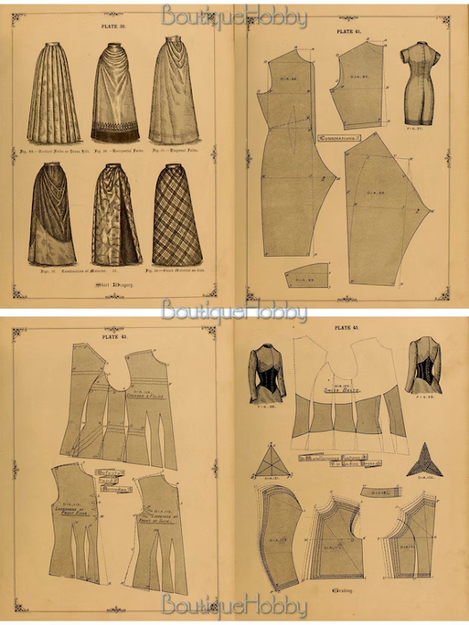
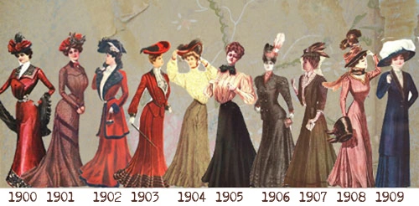
Clothing Pattern Ideas

Slide 10
Reflection: What’s Your Story?
What part of Ada’s story inspired you most?
What do you want people to take from your artwork?
What story would you want someone to draw about YOU?

