Slide 1

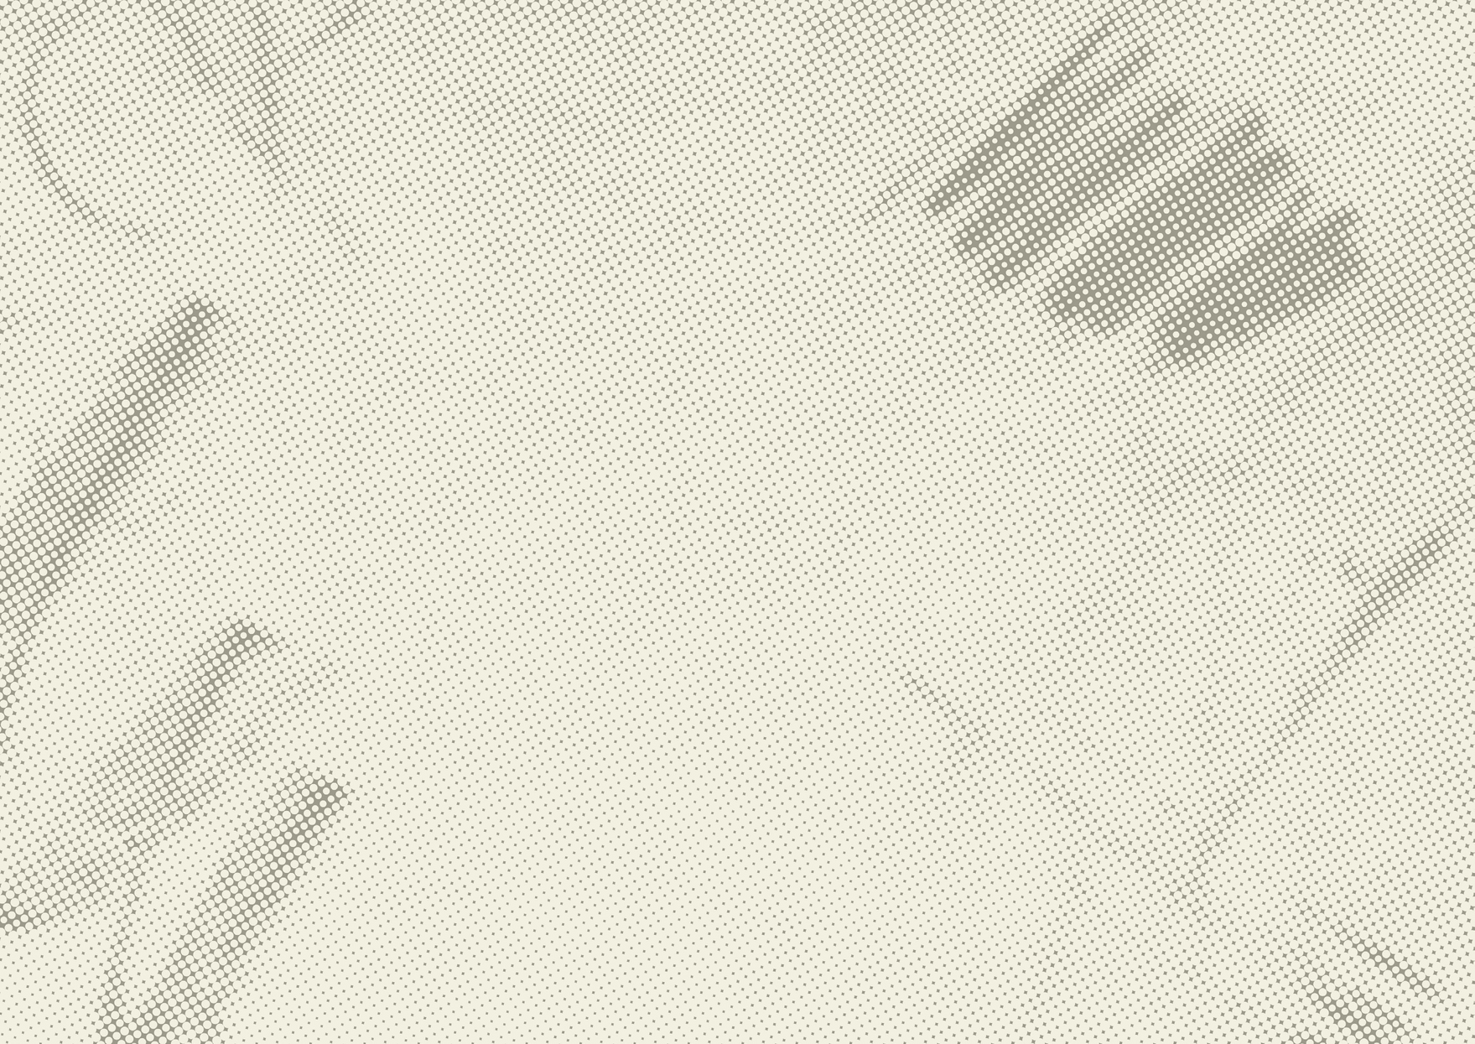


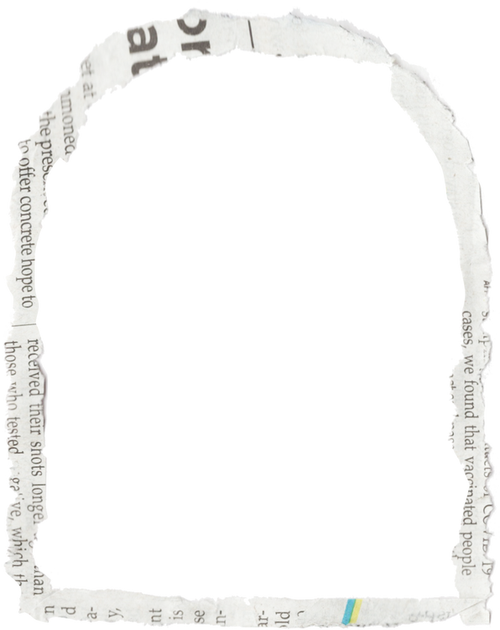
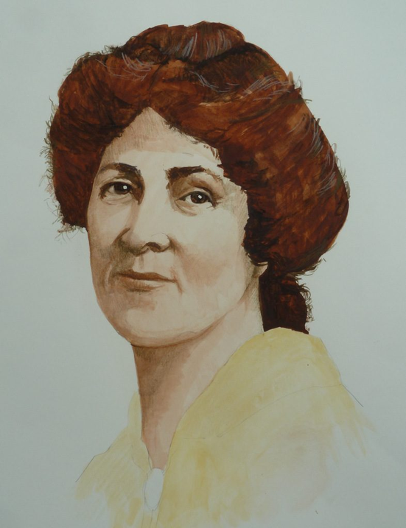

Voices for Change
Ada Nield Chew & Women Fighting for Change

Slide 2
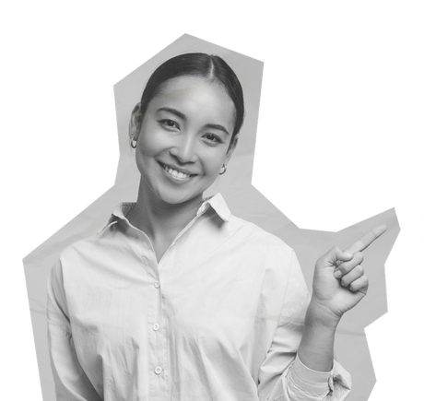
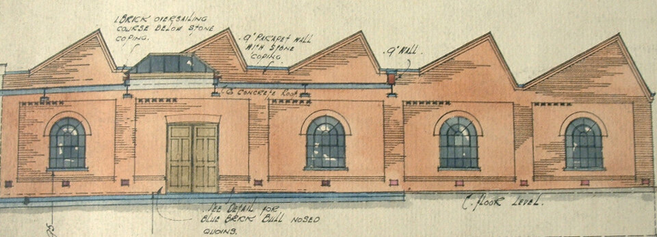
Who was Ada Nield Chew?
  Born 1870 in Crewe, worked in a clothing factory
  Wrote letters as 'Crewe Factory Girl' exposing conditions
  Became a speaker, writer, organiser for women's rights
  Peaceful campaigner – suffragist, not suffragette
  Active in Labour Party and Women’s Co-operative Guild

Slide 3
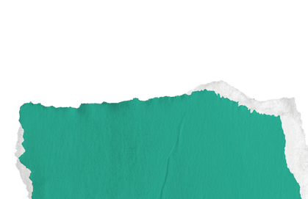

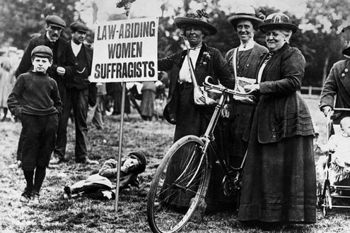
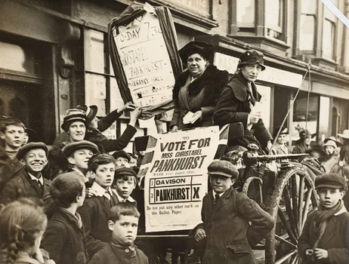

Suffragists vs Suffragettes
  Suffragists – peaceful, lawful campaigns (e.g. Ada)
  Suffragettes – militant, radical actions
  Suffragists – speeches, petitions, letters
  Suffragettes – chained to railings, hunger strikes

Slide 4
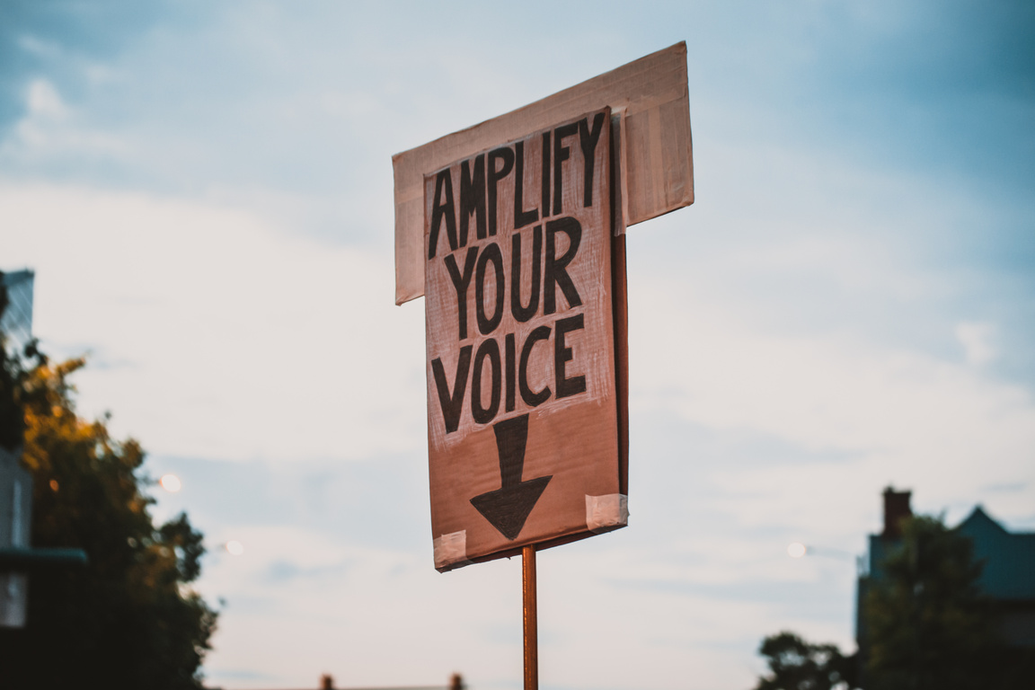
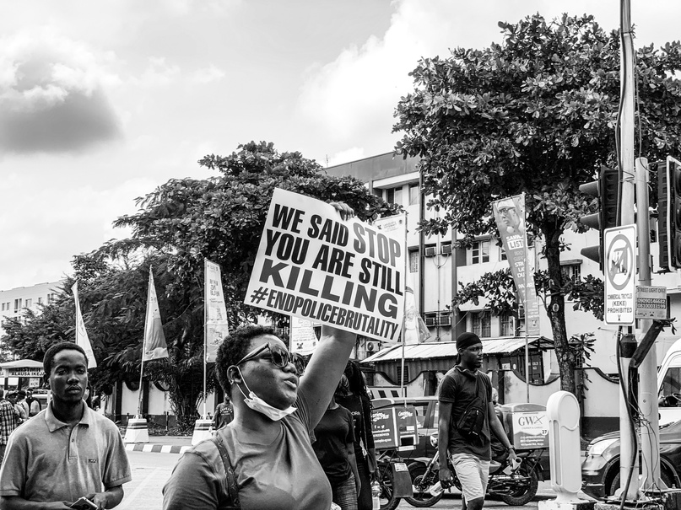
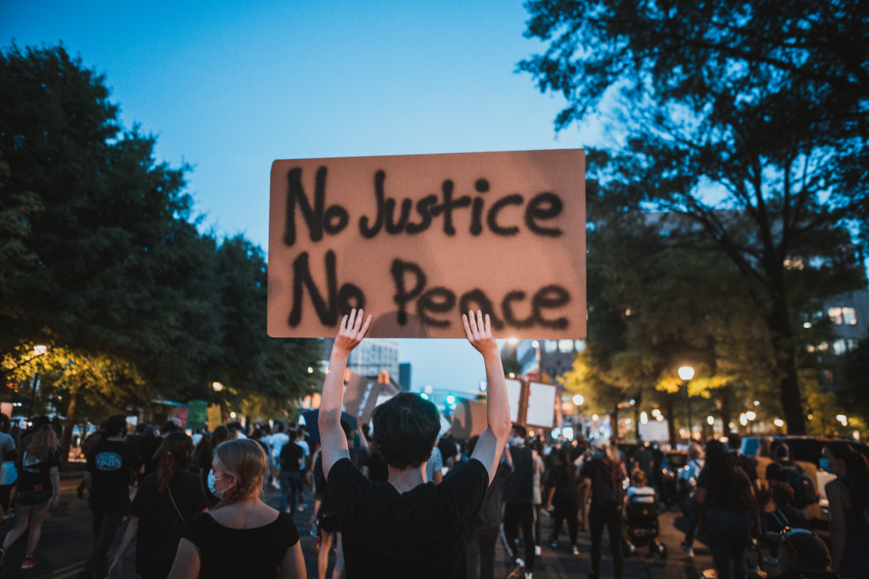
Why Protest Matters
  What makes protest powerful?
  What do you think Ada and other suffragists/ suffragettes were fighting for beyond voting?
  How do protest signs help communicate a cause?

Slide 5
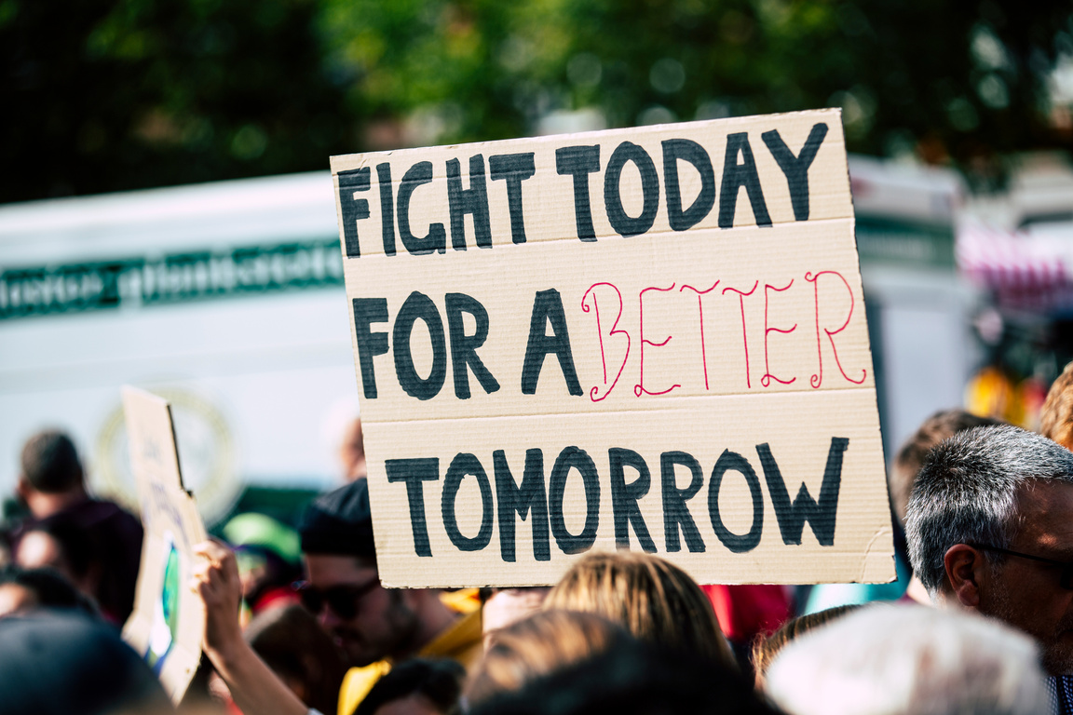
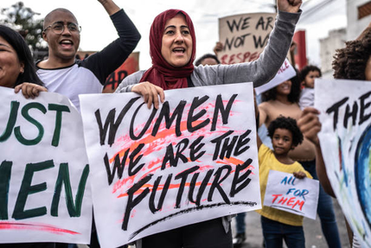
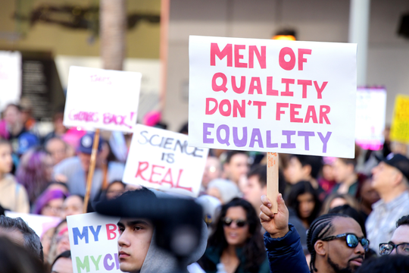
Make Your Own Protest Sign
  What would your sign say if you were Ada or a suffragette?
  Topics: equal pay, voting, education, your own cause
  Use colours, slogans, images- be bold!
  Example slogans: 'Votes for Women!', 'Education is Power!' ‘Equal pay!’ ‘Fair working conditions’

Slide 6
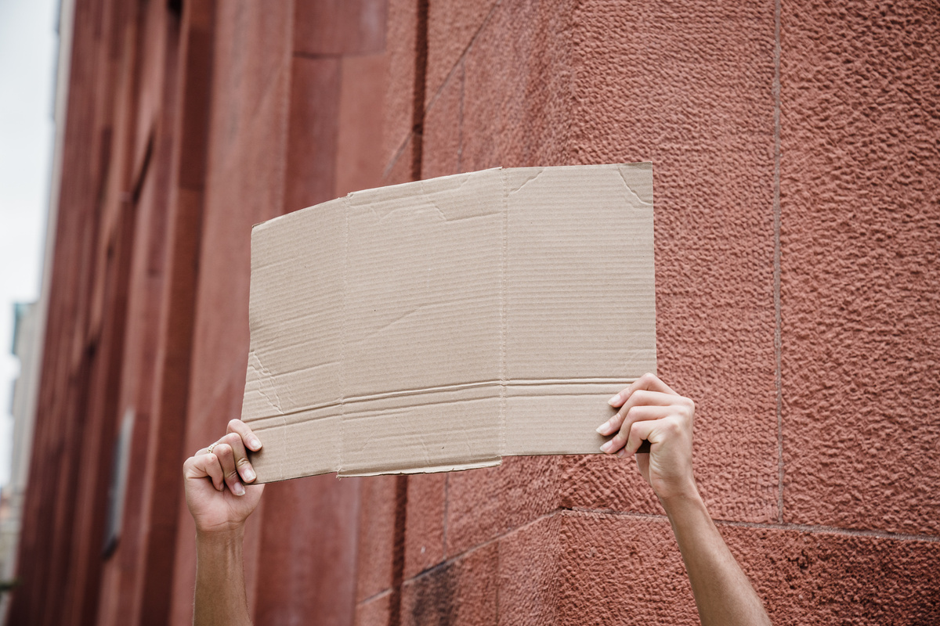
Sign Gallery
  Share your work!
  Hold up your sign
  Have a look at everyone’s messages
  Who wants to share their slogan?

Slide 7
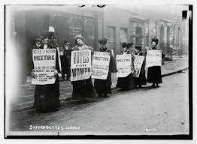
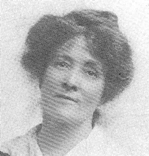
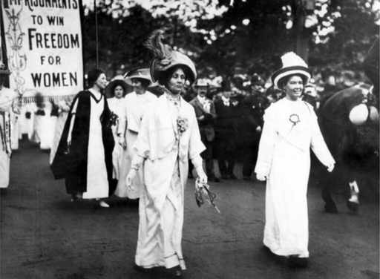
Wrap-Up & Reflection
  What did you learn about Ada Nield Chew?
  What would she campaign for today?
  How can we use our voices for change?

